Slide 1
CUDA Merge Sort
M.VENKATAKRISHNA

Slide 2
MERGE SORT PARALLEL ALGORITHM
EXPLAINED WITH 4 INITIAL SPLITS

Slide 3
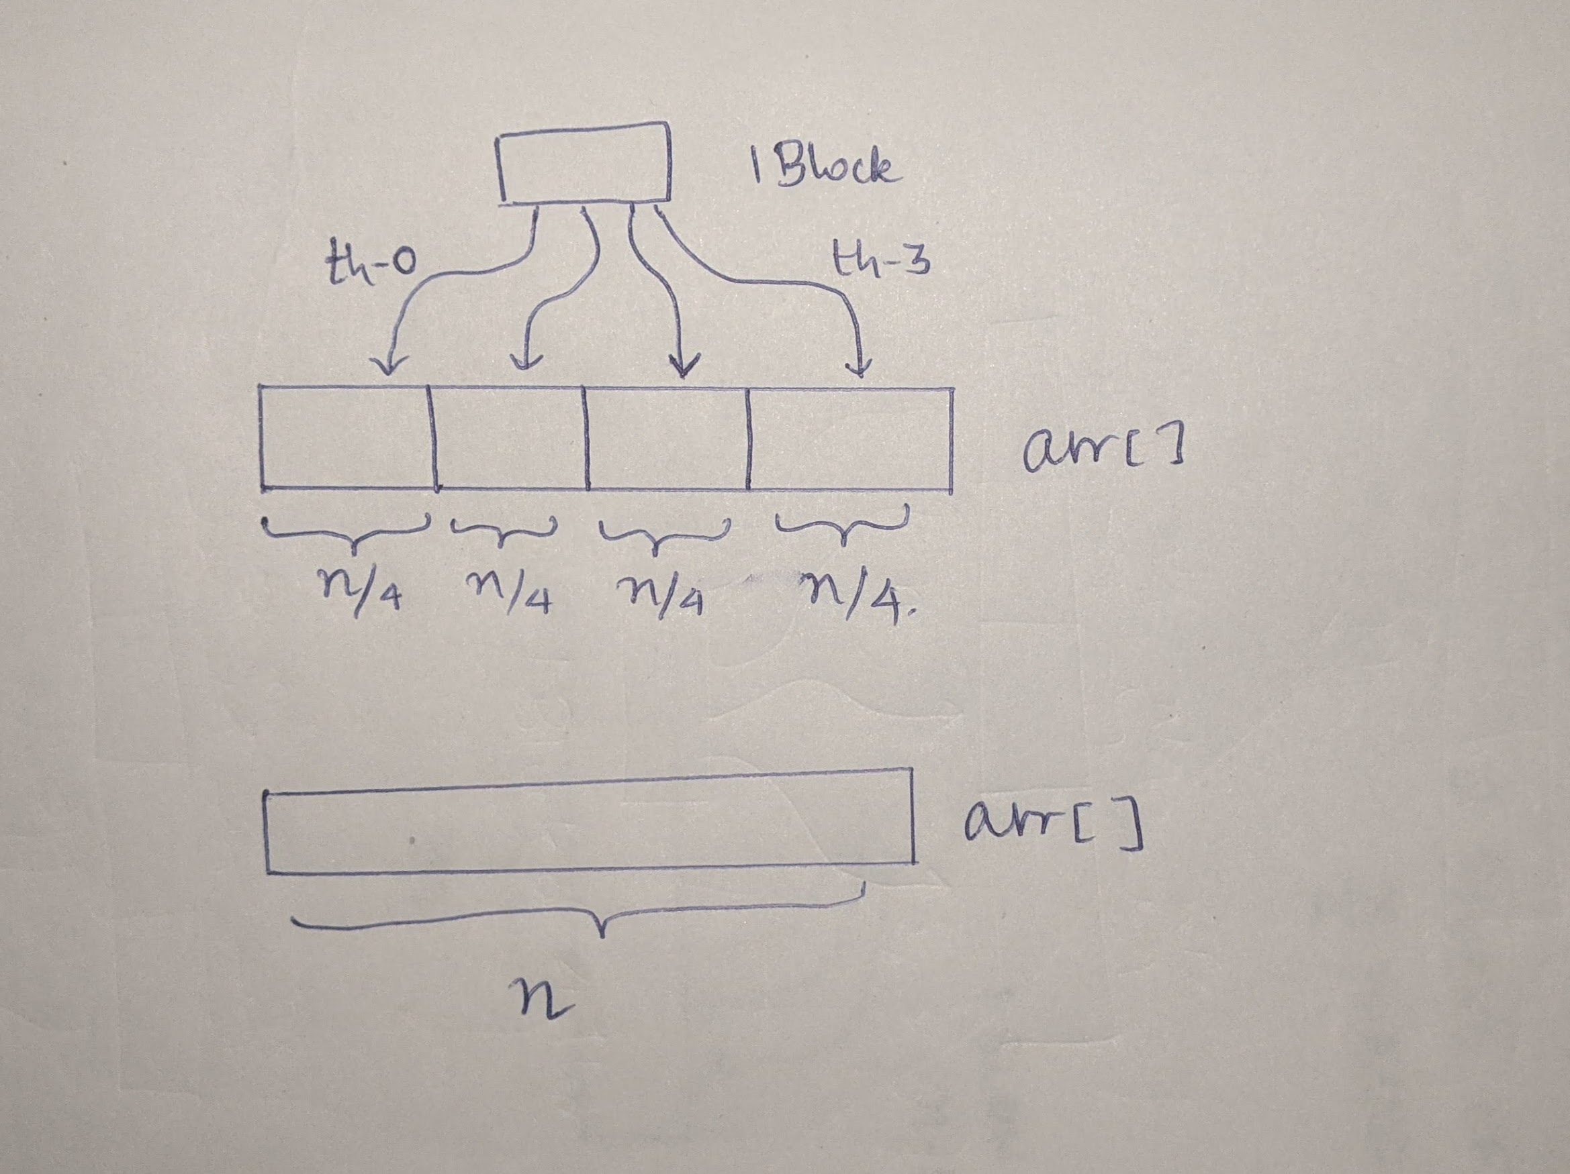
Stage-1
The original array arr[] is of size n
The array arr[] is initially split into 4 sections
A block of 4 threads is launched : Each thread is responsible for sorting each of the 4 sections. (BUBBLE-SORT IS EMPLOYED FOR THIS)

Slide 4
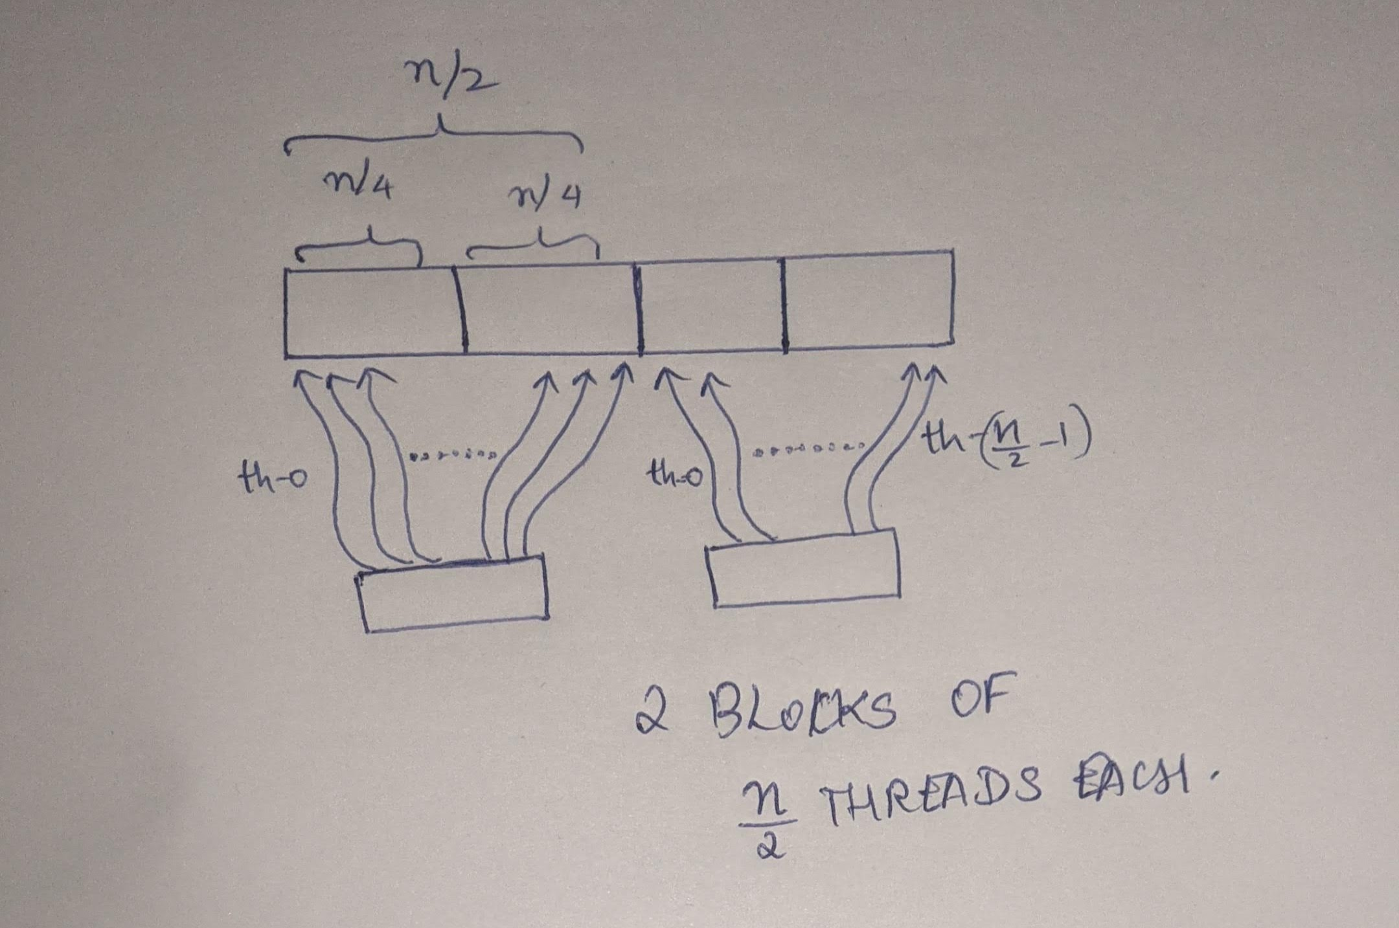
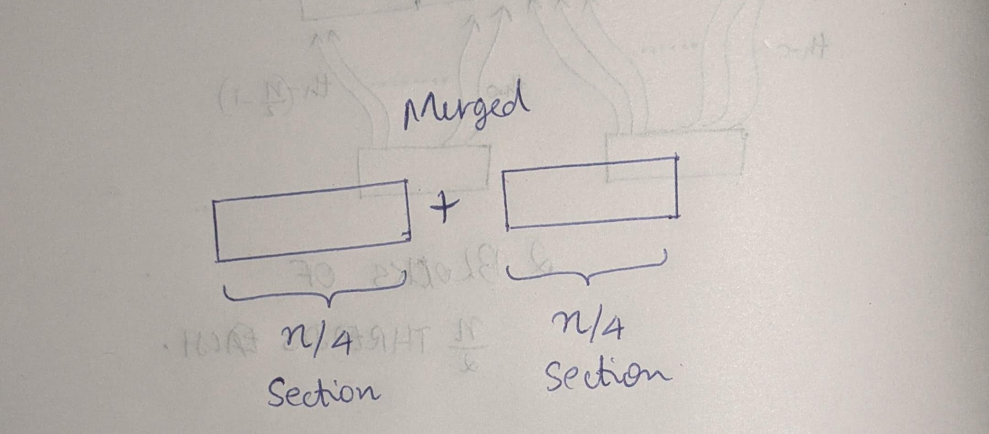
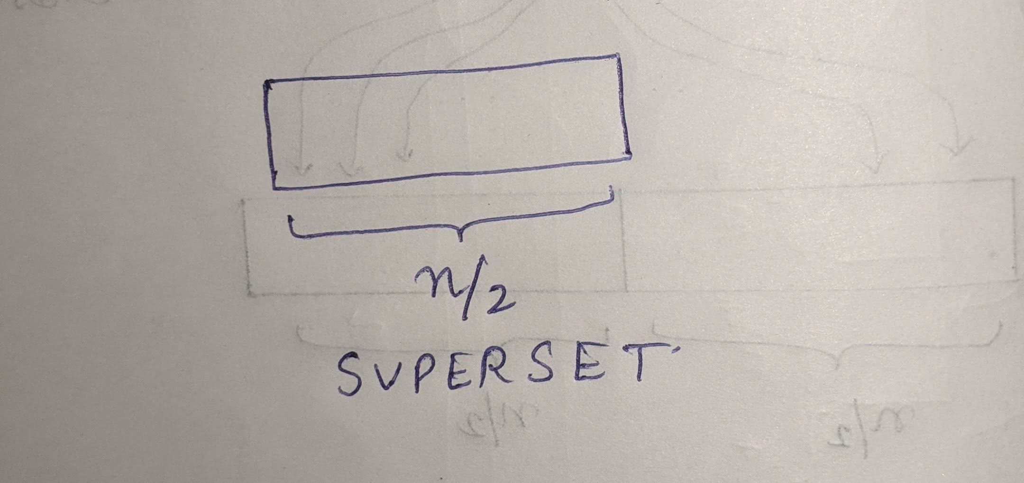
STAGE-2 (Iteration-1)
Now, each section of n/4 elements has been sorted (STAGE-1)
2 blocks of n/2 threads are launched.
Each block parallelly merges a pair of 2 sections of size: n/4 to produce a sorted SUPERSET of size: n/2
Each Block of n/2 threads is responsible for producing 1 SUPERSET of size: n/2

Slide 5
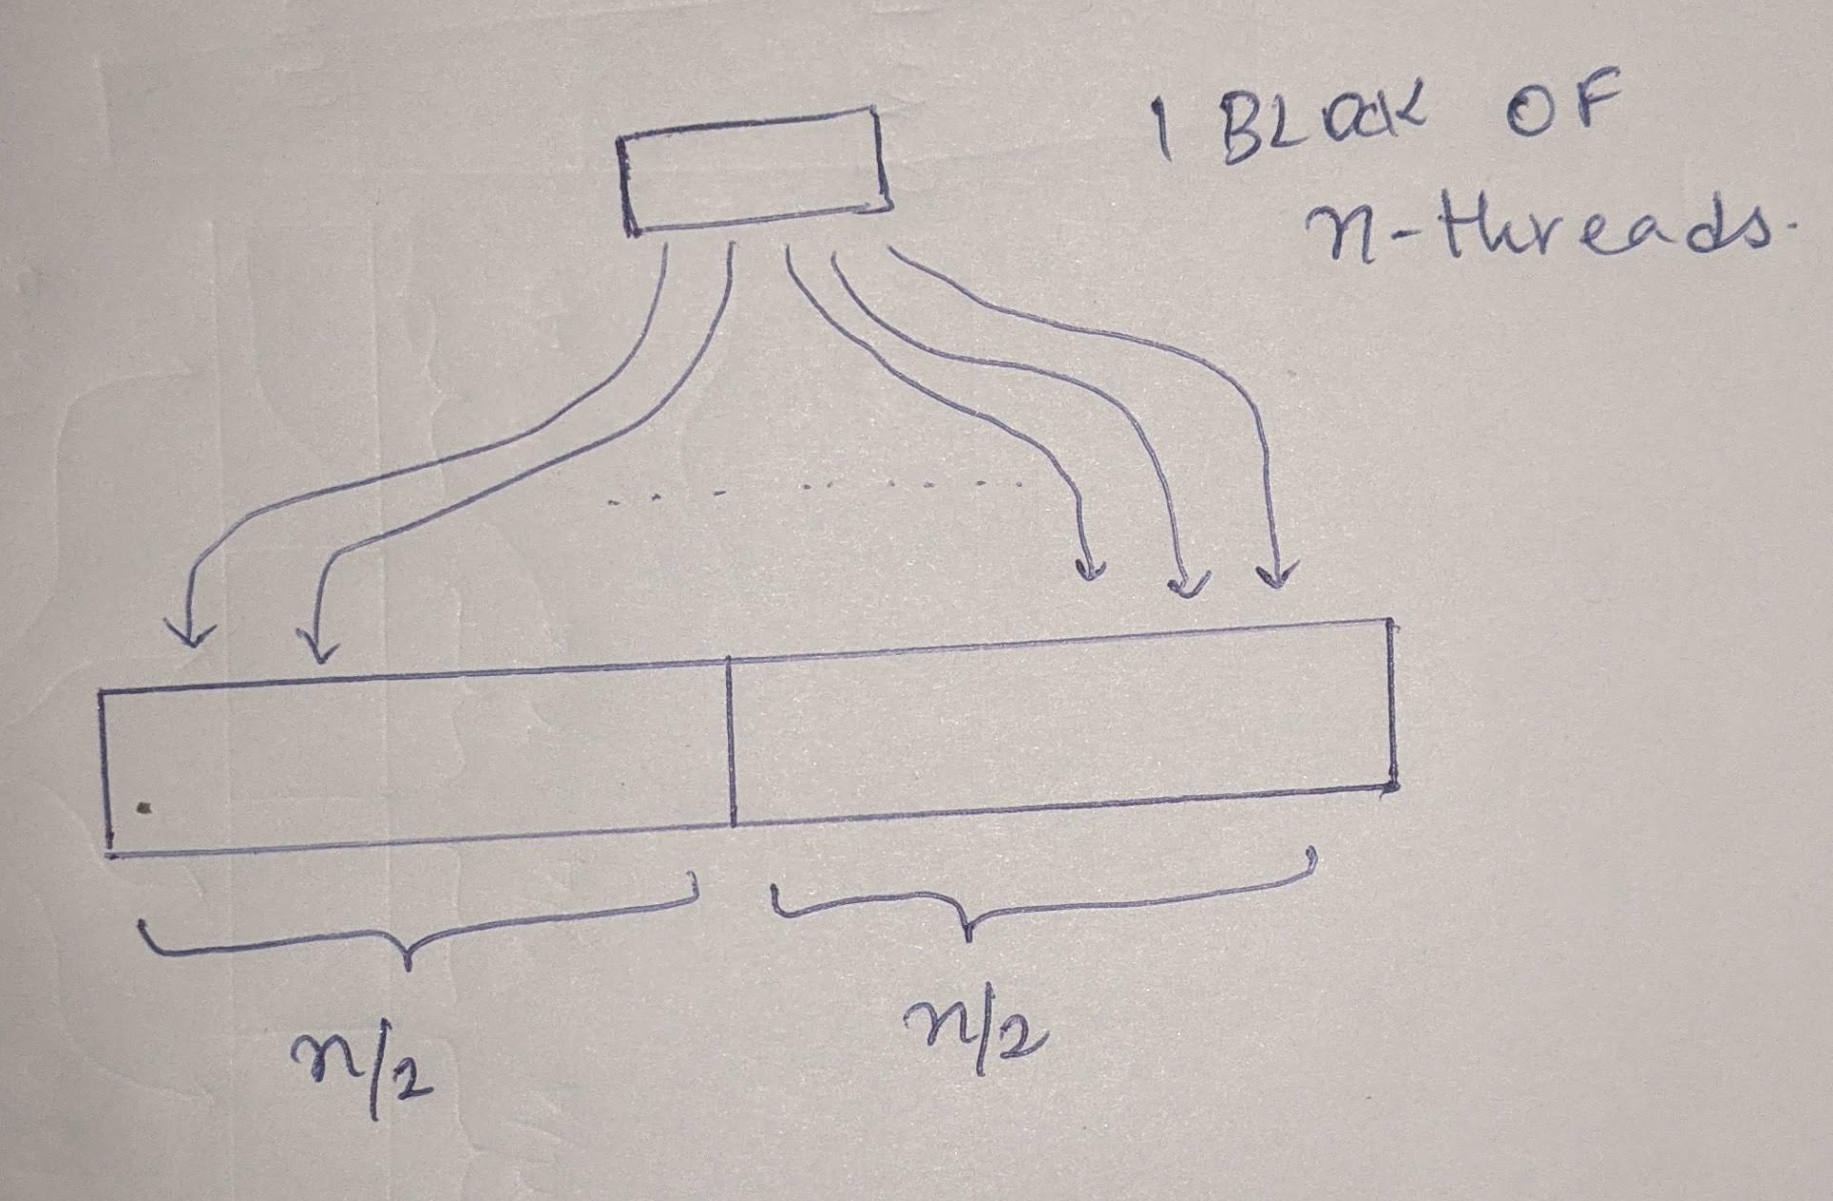
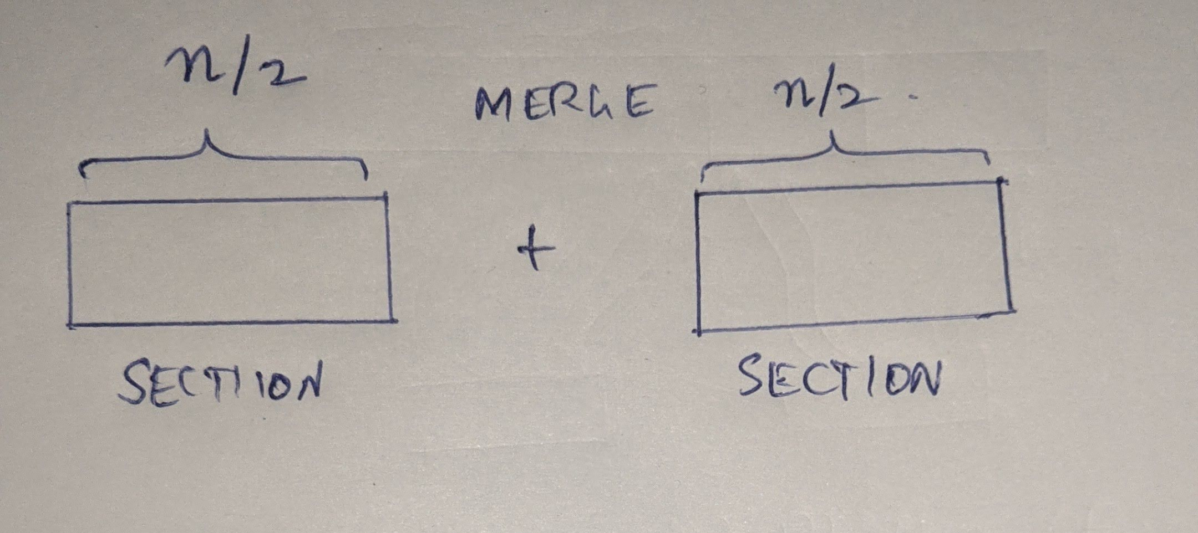
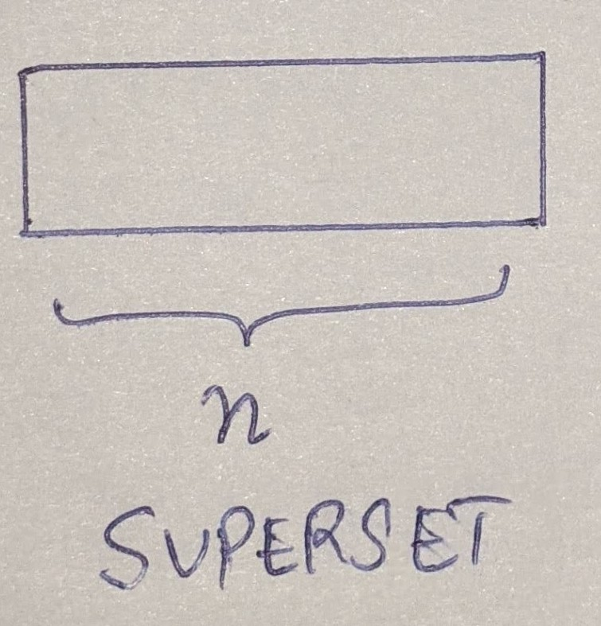
STAGE-2 (Iteration-2)
Now, each section of n/2 elements has been sorted (STAGE-2 Iteration 1)
1 blocks of n threads are launched.
This block merges a pair of 2 sections of size: n/2 to produce a sorted SUPERSET of size: n
This Block of n threads is responsible for producing 1 SUPERSET of size-n

Slide 6
MERGE SORT PARALLEL ALGORITHM
EXAMPLE RUN WITH 4 INITIAL SPLITS
Example arr[] = {5,1,15,14,10,13,3,2,20,17,21,22,18,16,25,24}

Slide 7
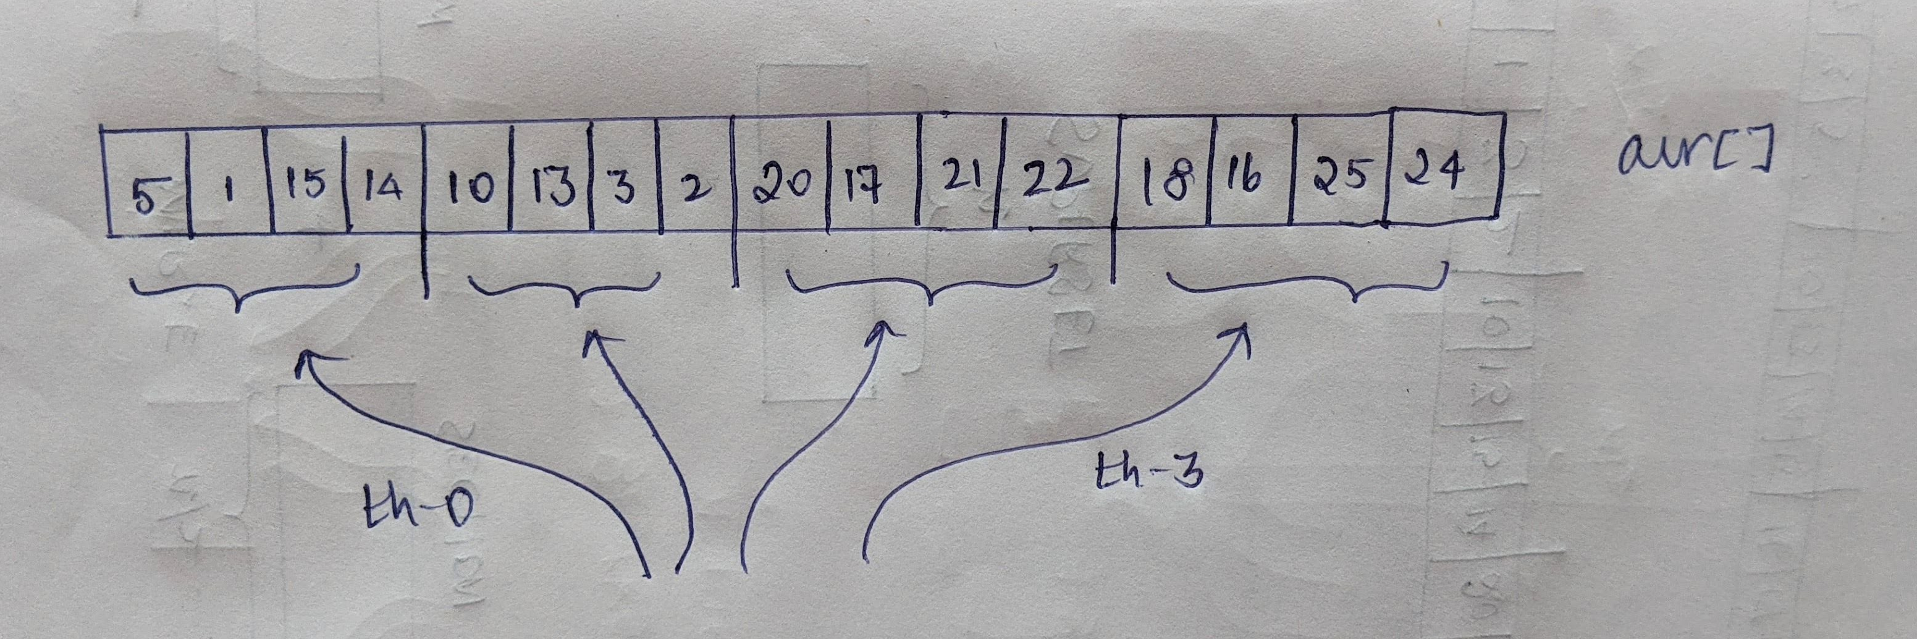
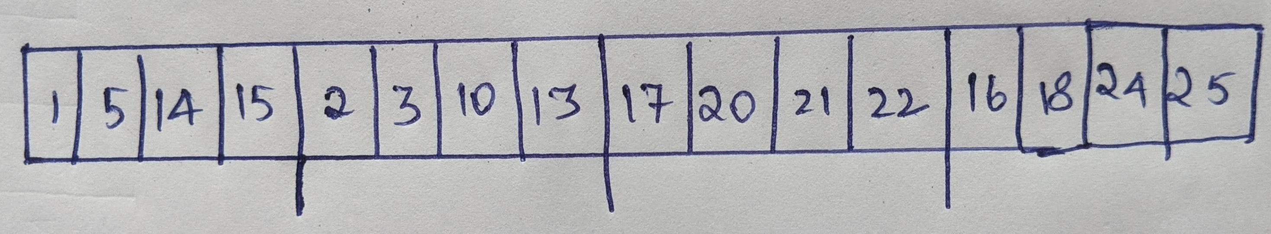
STAGE-1: ARRAY IS DIVIDED INTO SECTIONS AND EACH SECTION IS SORTED
4 threads are launched
Each thread individually sorts a section of 4 elements

Slide 8
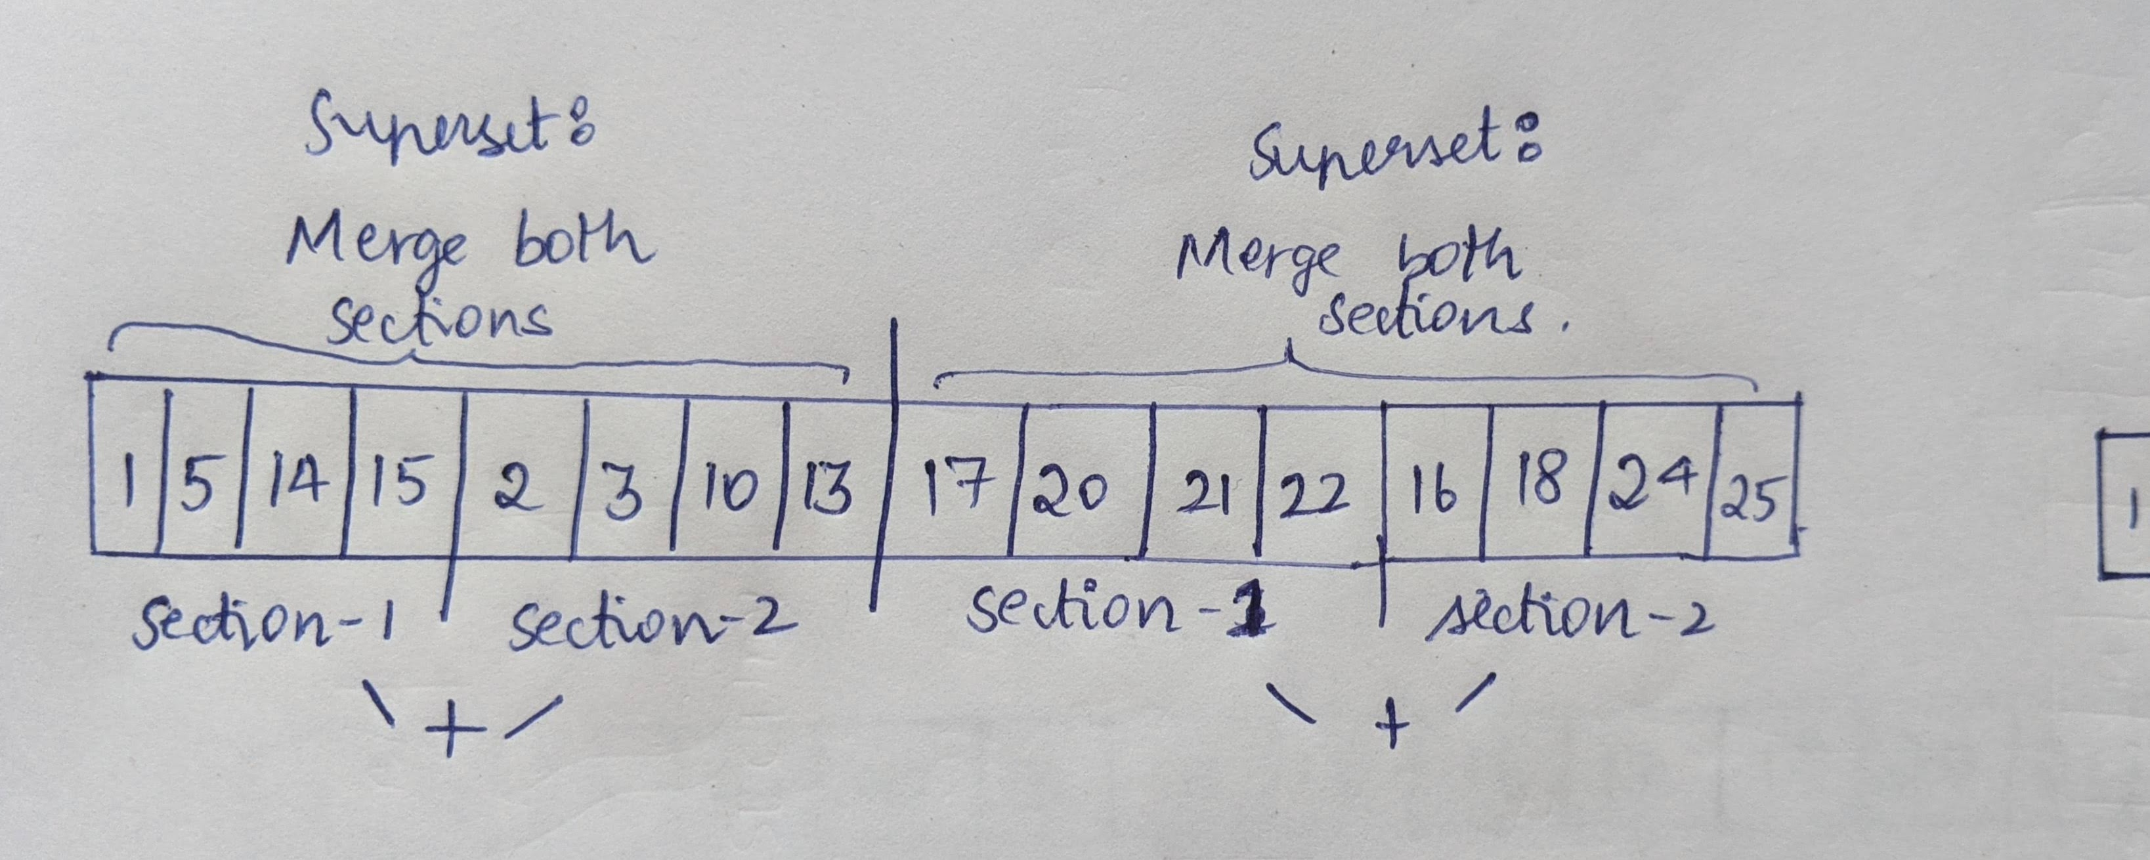
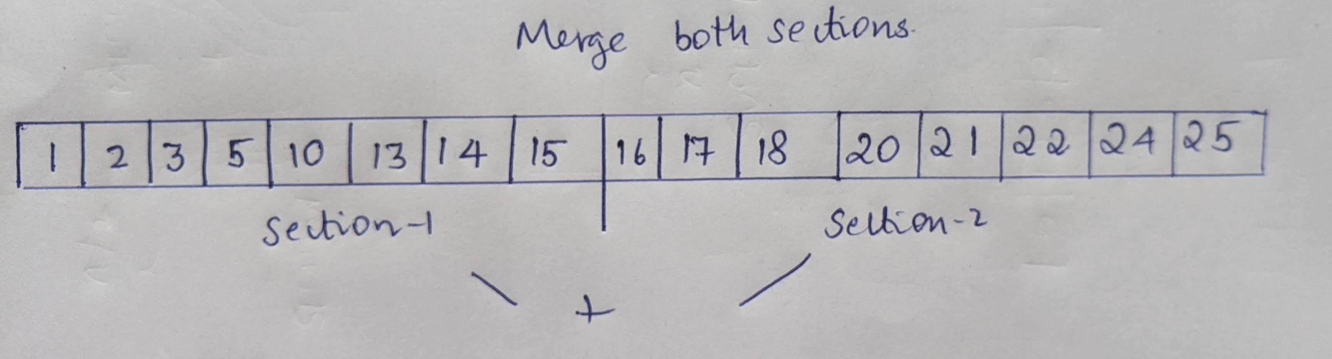
STAGE 2: ITERATION-1 EACH SORTED SECTION IS MERGED IN PAIRS TO PRODUCE SORTED SUPERSETS
2 Sections on left are merged to form a sorted superset in left
2 sections in right are merged to form a sorted superset in right

Slide 9
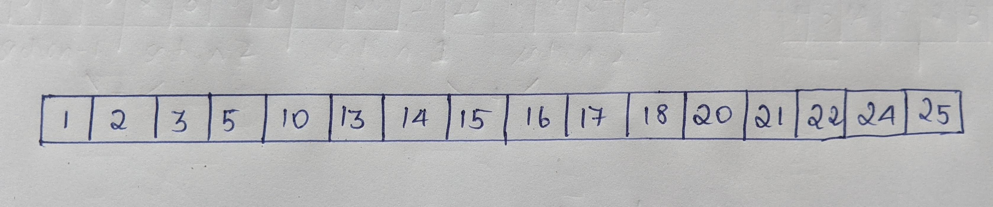
STAGE 2: ITERATION-2 EACH SORTED SECTION IS MERGED IN PAIRS TO PRODUCE SORTED SUPERSETS
2 Sorted Sections of size-n/2 each are merged to form a sorted superset of size n

Slide 10
SORTED ARRAY IS FINALLY OBTAINED
arr[] = {1,2,3,5,10,13,14,15,16,17,18,20,21,22,24,25}

Slide 11
MERGE SORT CUDA IMPLEMENTATION

Slide 12
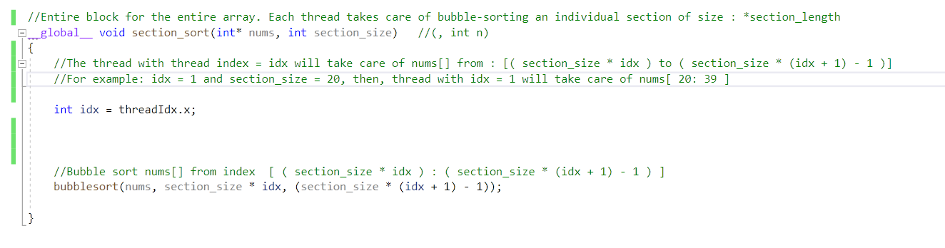
KERNEL : section_sort()
Takes as INPUT:
nums* : The input array , which is to be divided into sections and sorted sectionally
section_size : The size (number of elements) of each section
Produces OUTPUT:
nums[] Input array but with each section individually sorted

Slide 13
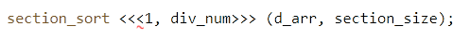
section_sort() : KERNEL-CALL AND WORKING
div_num = Number of sections into which arr[] is split into.
A single block of div_num number of threads are launched.
Each thread will be responsible for sorting one specific section of the arr[].
Thread number idx will be responsible for the section:
[ idx * section_size : (idx+1) * section_size - 1 ]
Bubble-Sort() is employed by each thread to sort the section its responsible for.

Slide 14
Stage-2
Merge Sorted Sections

Slide 15
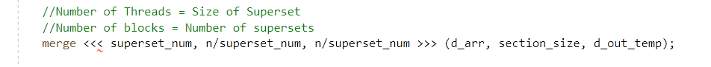
Merge Kernel Call
Number of Blocks = Number of Supersets
Number of threads = Length of each superset
Each Block : Is responsible for a superset (merging the 2 sections of its superset)
Each thread : Is responsible for 1 element of the superset

Slide 16
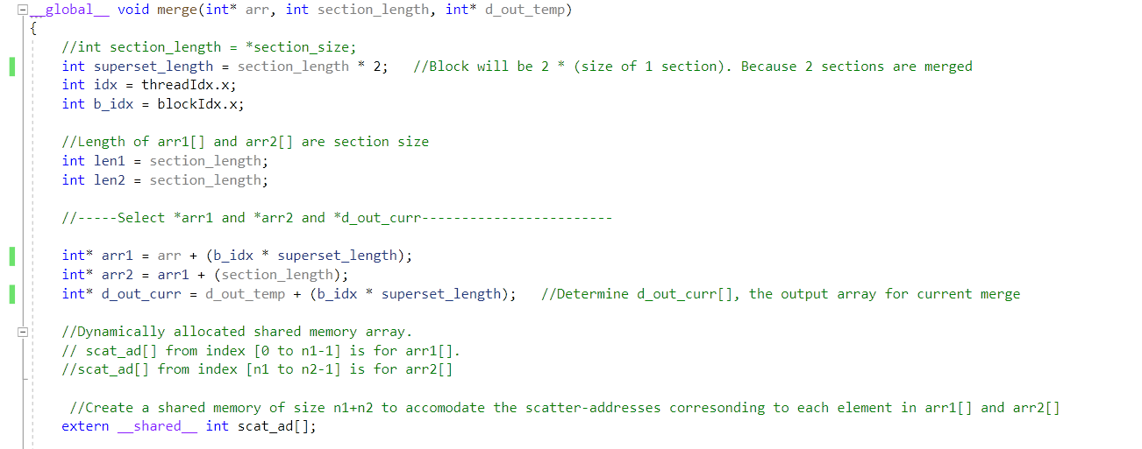
KERNEL: merge()
Takes as INPUT:
arr* : Input array
section_length : length of each section, which are to be merged in pairs
d_out_temp* : temporary array used to store intermediate output
Produces As Output:
arr[] but with pairs of sections of section_length merged to form bigger sections of size section_length*2

Slide 17
Merge Kernel :Details
section : Divisions in arr[] . They will be merged in pairs.
superset : The result formed from merging to 2 sorted sections
superset_length : Length of each superset.
arr1* : Points to first section of superset.
arr2* : Points to second section of superset
len1 = len2 = Length of arr1[] = Length of arr2[]
scat_ad[] : A shared memory array of length = superset-length.
It will hold the scatter addresses for each element of sorted superset

Slide 18
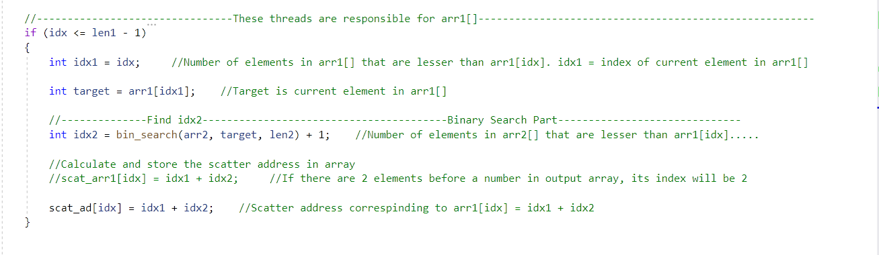
Merge : Scatter Address Calculation
Each thread is responsible for producing scatter address of one element in the superset
If (thread index < len1): Current thread is responsible for an element in arr1[]
Target = arr1[idx] (Current Number whose scatter address is to be calculated)
Idx1 = Number of elements smaller than target in arr1[] = idx
Idx2 = Number of elements smaller than target in arr2[]
To calculate idx2, we perform a binary_search for target in arr2[]
Scatter address of arr[idx] in sorted array will be (idx1 + idx2), i.e, the number of elements in superset smaller than target. Hence, store scatt_ad[idx]= idx1+idx2

Slide 19
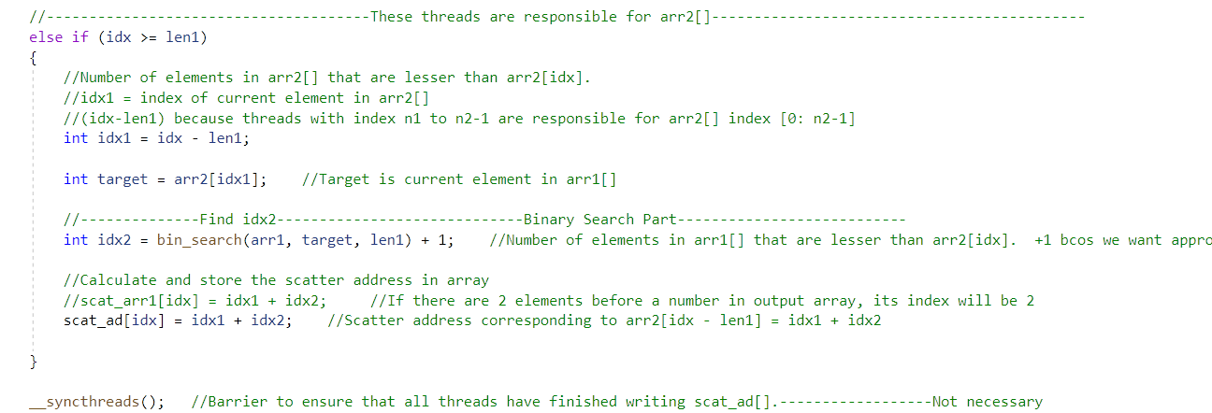
If idx >= len1: Current thread is responsible for an element in arr2[]
Calculating scatter address is similar to previous case
__syncthread() : Barrier to ensure all threads have finished calculating scatter addresses.

Slide 20
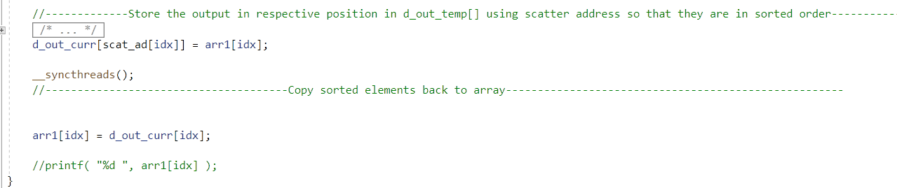
Place the elements in Superset in appropriate sorted positions
1)Store the elements in current superset from arr[] to d_out[] in appropriate sorted position using scatter address from scat_ad[] array (d_out[] is temporary array)
2)Barrier : Ensure all threads have finished copying to d_out[]
3) Copy back to arr[] from d_out[]

Slide 21
merge_sort()
CPU CODE

Slide 22
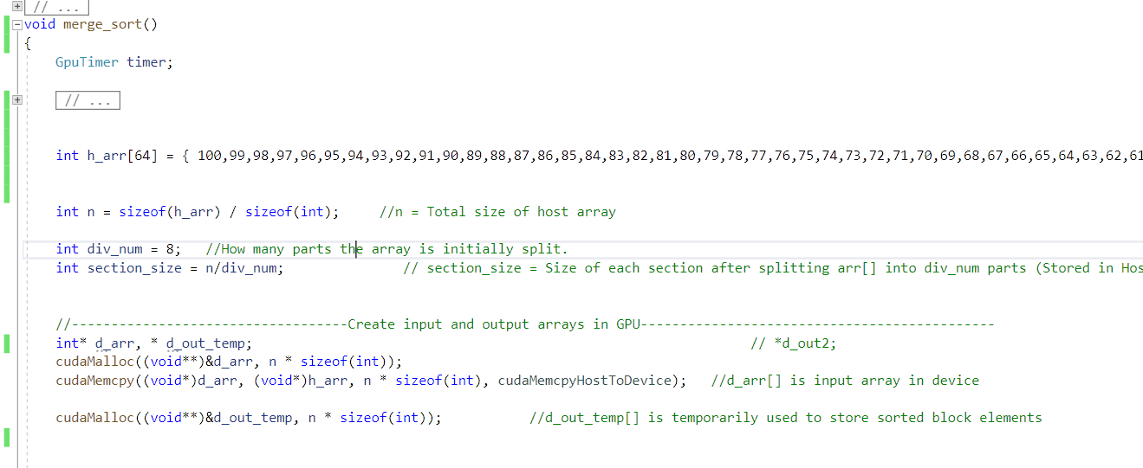
merge_sort() Function
h_arr[] : Input array to be sorted (Stored in HOST)
d_arr[] : Input array (Stored in Device)
d_out_temp[] : temporary array (Device)

Slide 23
contd.
div_num: Number of sections into which the arr[] is initially SPLIT
section_size: Length of each section = Total array length / number of sections = n /div_num

Slide 24
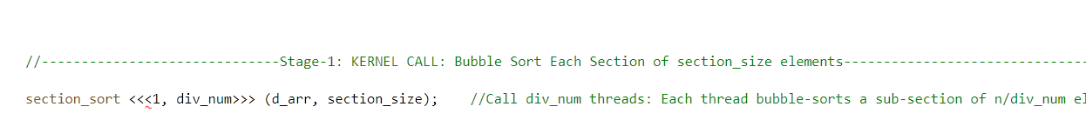
STAGE – 1: SECTION-SORT KERNEL CALL
section-sort kernel call will bubble-sort all sections in arr[]. (The array is divided into div_num number of sections each of section_size)
KERNEL calls 1 block of div_num threads, 1 thread for each section in arr[].
Each thread will sort its section

Slide 25
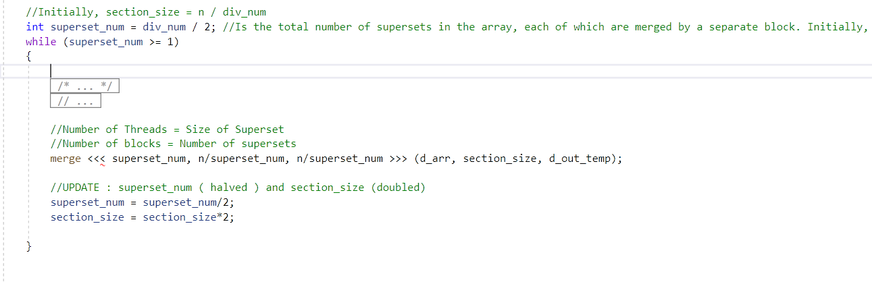
STAGE-2: ITERATIVELY MERGE SECTIONS UNTIL ENTIRE ARRAY IS SORTED
Iteratively call merge kernel
In each iteration, merge sections into supersets.
After each iteration, section size is doubled and number of superset is halved (Because after each iteration, each pair of section is merged, so that current superset is a section for the next iteration )
In Final iteration, only a single pair of sections is to be merged and then, sorted array will be obtained

Slide 26
END

